Slide 1

Introduction to Nuclear Physics and X-ray
17.10.17

Slide 2

Outline
Terminology: Atom model
Radiation types and uses
$α$ decay
$β$ decay
X-ray and $γ$ radiation
Decay schemes:
one decay
chain decay
parallel decay

Slide 3
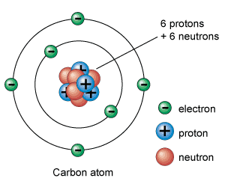
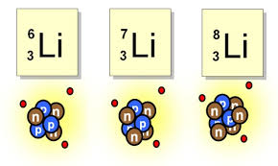
Terminology: Atom Model
Nucleus
Electron orbitals
Isotopes differ in neutron number
Non stable isotopes are radioactive

Slide 4
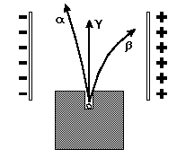
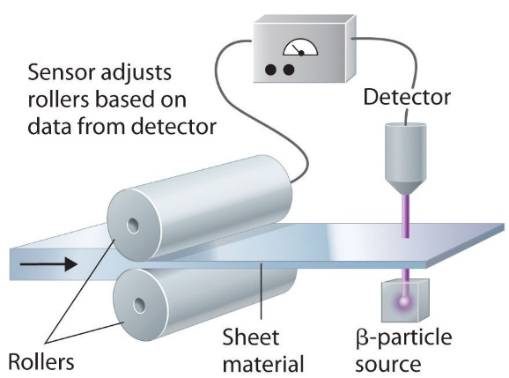

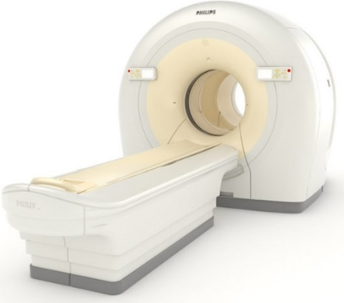
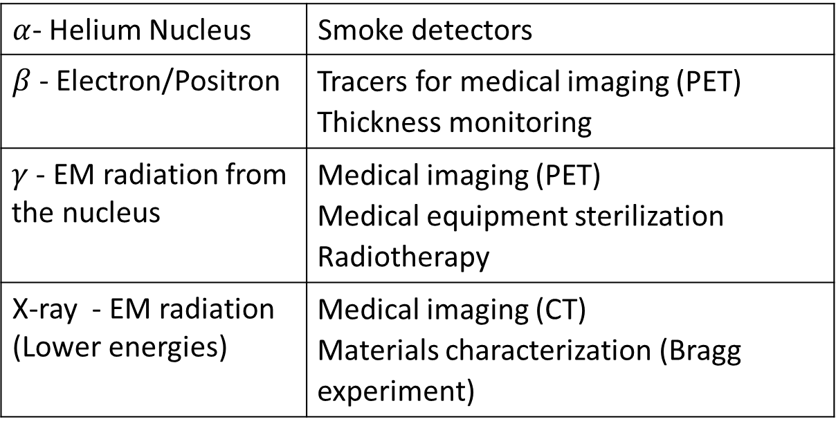
Radiation Types and Uses
Smoke detectors | $α$- Helium Nucleus
Tracers for medical imaging (PET) Thickness monitoring | $β$- Electron/Positron
Medical imaging (PET) Medical equipment sterilization Radiotherapy | $γ$ - EM radiation from the nucleus
Medical imaging (CT) Materials characterization (Bragg experiment) | X-ray - EM radiation (Lower energies)
Am-smoke detectors
PET

Slide 5
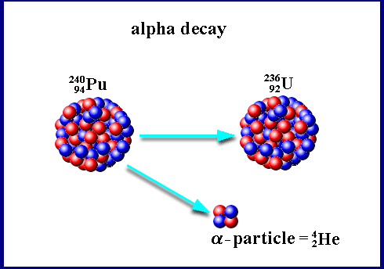
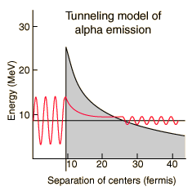
α-decay
Main interaction: nuclear strong interaction (range ~10⁻¹⁵m) counters Coulomb force.
Physical effect: quantum tunneling
Atomic mass >210u
Energy range: 4-25MeV

Slide 6
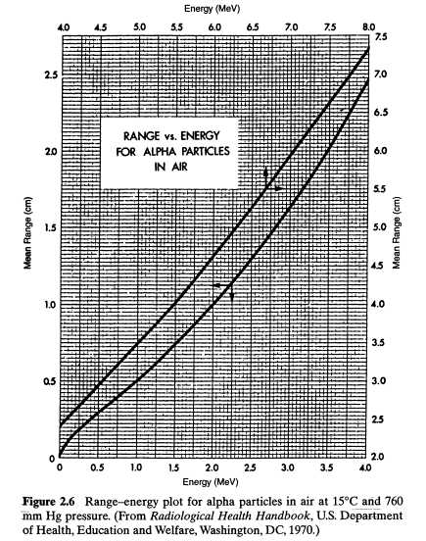
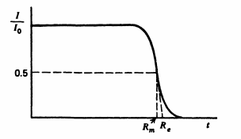
α-decay: Range-Energy Plot
Mean range definition
For more information see
Glenn F. Knoll, Radiation detection and measurements

Slide 7
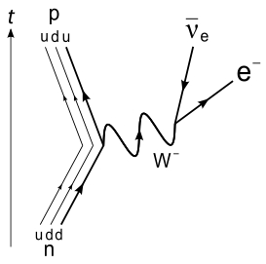
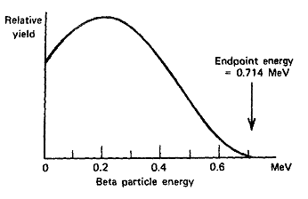
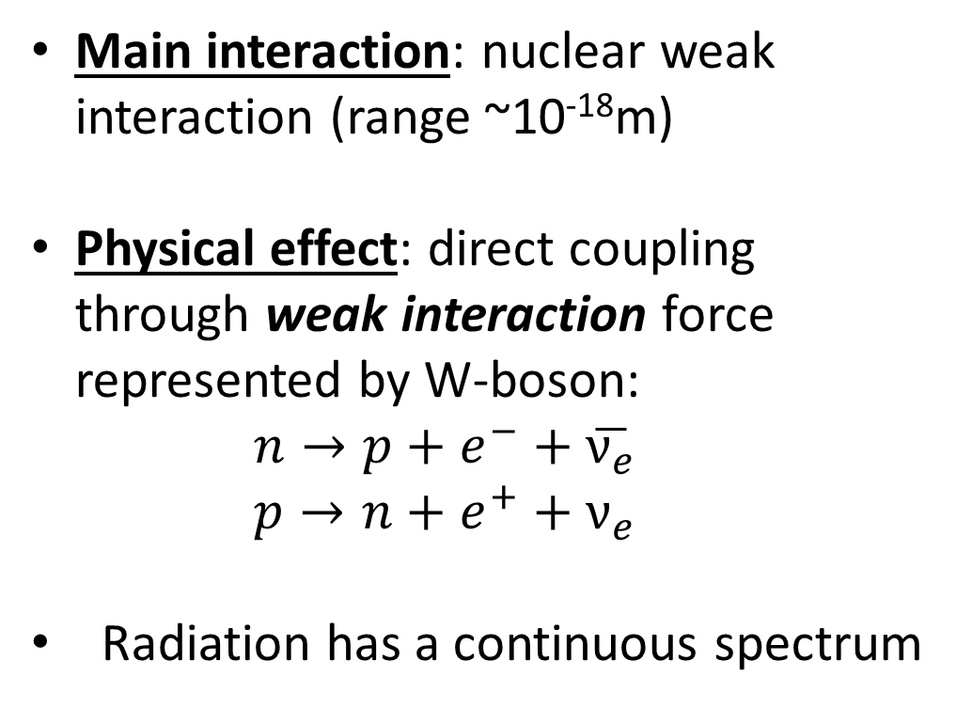
β-decay
Main interaction: nuclear weak interaction (range ~10⁻¹⁸m)
Physical effect: direct coupling through weak interaction force represented by W-boson:
$$n→p+e^{−}+\overline{ν_{e}}$$
$$p→n+e^{+}+ν_{e}$$
Radiation has a continuous spectrum

Slide 8
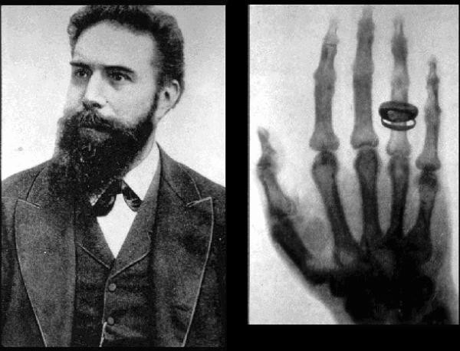
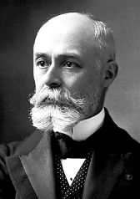

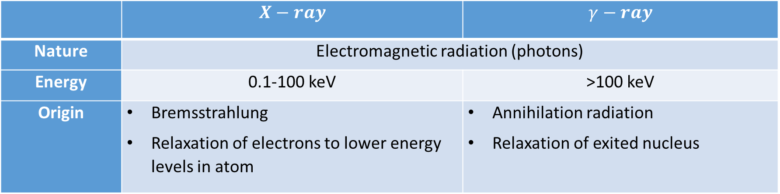
X-ray vs. $γ$ Radiation
$$γ−ray$$ | $$X−ray$$
Electromagnetic radiation (photons) |  | Nature
>100 keV | 0.1-100 keV | Energy
Annihilation radiation Relaxation of exited nucleus | Bremsstrahlung Relaxation of electrons to lower energy levels in atom | Origin
Wilhelm Röntgen (1895)
Antoine Henri Bequerel (1896)

Slide 9
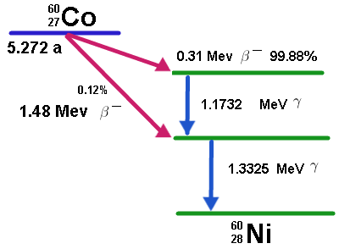
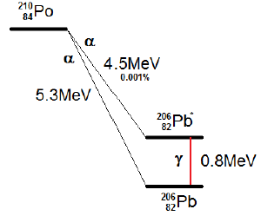


$γ$-decay
$γ$-decay following α or β decay:
Emission by exited nuclei relaxation to lower nuclear level

Slide 10
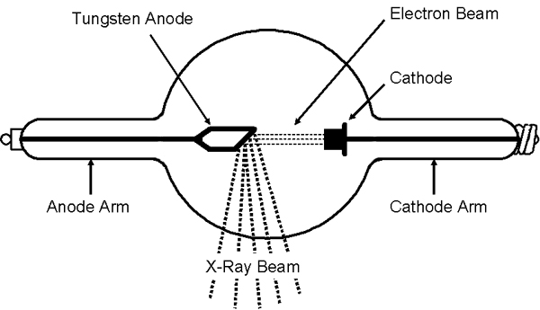
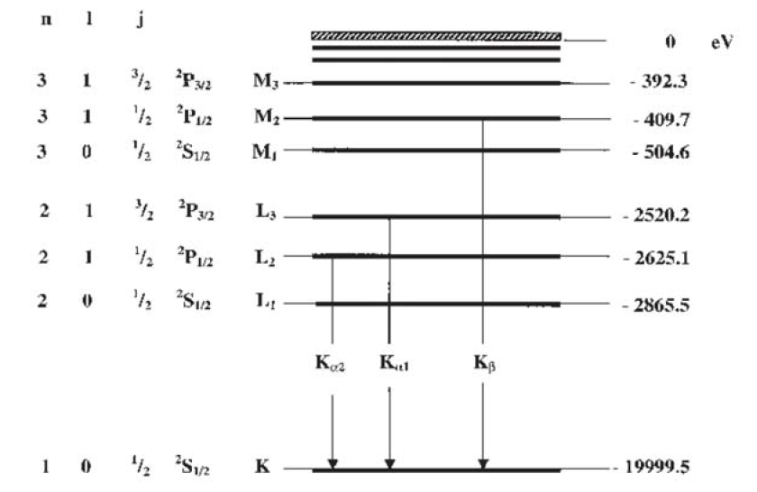
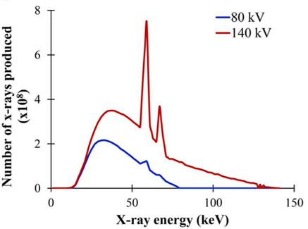
X-ray Radiation Generation
Synchrotron
X-ray tube
Bremsstrahlung
Characteristic lines
Energy-level diagram of iron (Z = 26)

Slide 11
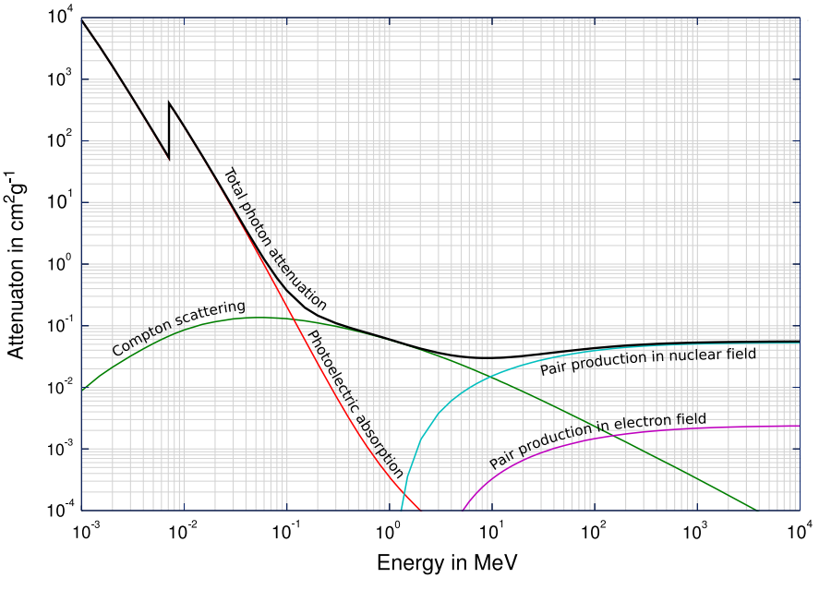
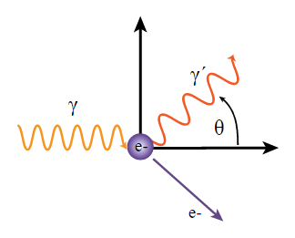
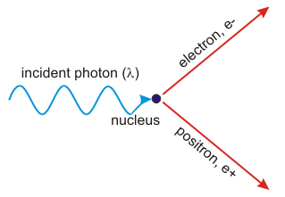

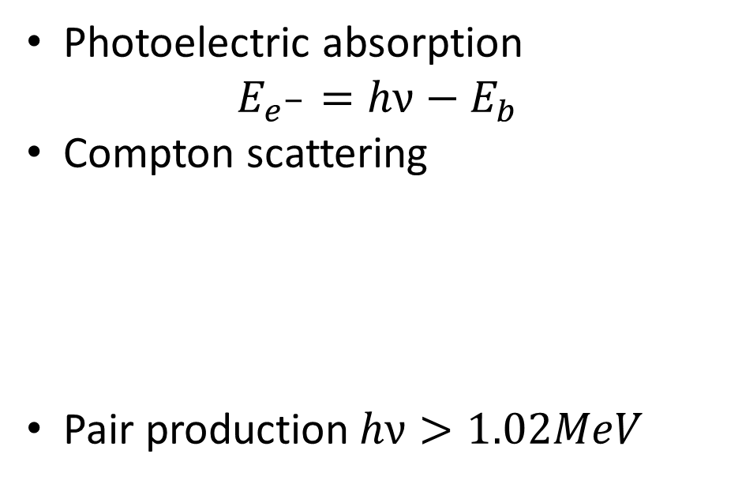
$EM$ Radiation: Interaction With Matter
Photoelectric absorption
$$E_{e^{−}}=hν−E_{b}$$
Compton scattering
Pair production$hν>1.02MeV$
Total photon cross sections. Source: Wikimedia Commons

Slide 12

Outline
Terminology: Atom model
Radiation types and uses
$α$ decay
$β$ decay
X-ray and $γ$ radiation
Decay schemes:
one decay
chain decay
parallel decay

Slide 13
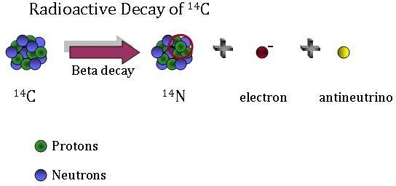


Decay Schemes: One Decay Process
one-decay process $A\overset{→}{λ}B$, B is stable
The number of decays has a Poisson distribution
Half-life: $t_{1/2}=\frac{ln2}{λ}$
$$\frac{dN}{dt}=−λN$$
$$N\left(t\right)=N_{0}exp\left(−λt\right)$$
$$N_{A}+N_{B}=N_{tot}$$

Slide 14
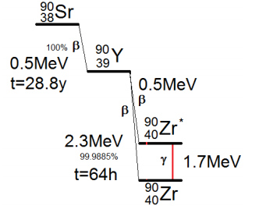


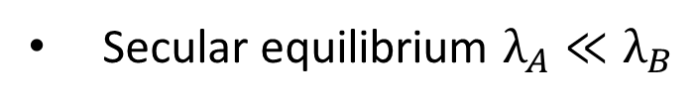
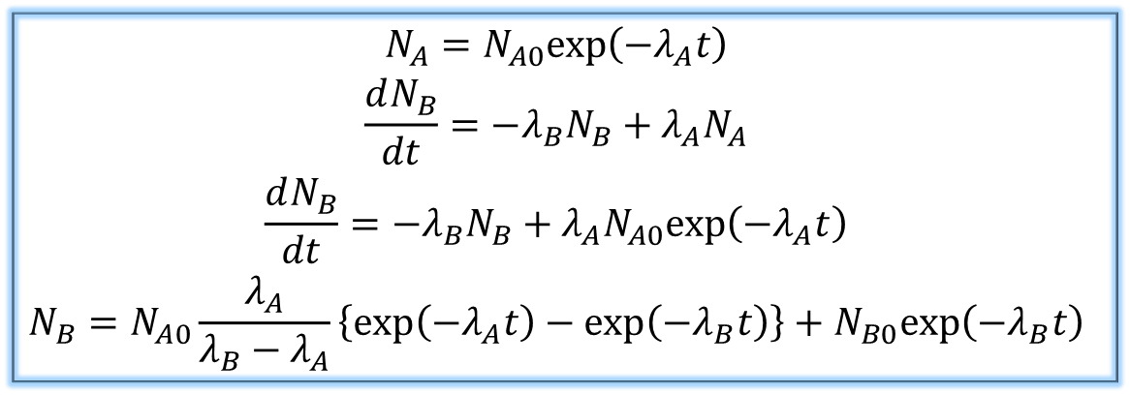
Decay Schemes: Chain-Decay Process
Series of decay process $A\overset{→}{λ_{A}}B\overset{→}{λ_{B}}$C
Radioactive equilibria:
$$\begin{matrix}\begin{aligned}N_{A}=N_{A0}exp\left(−λ_{A}t\right) \\ \frac{dN_{B}}{dt}=−λ_{B}N_{B}+λ_{A}N_{A} \\ \frac{dN_{B}}{dt}=−λ_{B}N_{B}+λ_{A}N_{A0}exp\left(−λ_{A}t\right)\end{aligned} \\ N_{B}=N_{A0}\frac{λ_{A}}{λ_{B}−λ_{A}}\left\{exp\left(−λ_{A}t\right)−exp\left(−λ_{B}t\right)\right\}+N_{B0}exp\left(−λ_{B}t\right)\end{matrix}$$
Secular equilibrium $λ_{A}≪λ_{B}$
$N_{B}=N_{A0}\frac{λ_{A}}{λ_{B}}exp\left(−λ_{A}t\right) →{ λ}_{B}N_{B}$=$λ_{A}N_{A}$

Slide 15
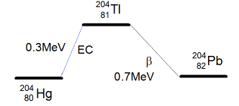


Decay schemes : Parallel Decay Process
Parallel Decay Process $A\overset{→}{λ_{B}}B$, $A\overset{→}{λ_{C}}C$
$$\begin{matrix}\frac{dN_{A}}{dt}=−\left(\frac{dN_{B}}{dt}+\frac{dN_{C}}{dt}\right) \\ \begin{aligned}N_{i}=\frac{λ_{i}}{λ_{i}+λ_{j}}N_{A0}\left\{1−exp\left[−\left(λ_{i}+λ_{j}\right)t\right]\right\} \\ for \left(i,j\right)∈\{B,C\}\end{aligned}\end{matrix}$$

Slide 16
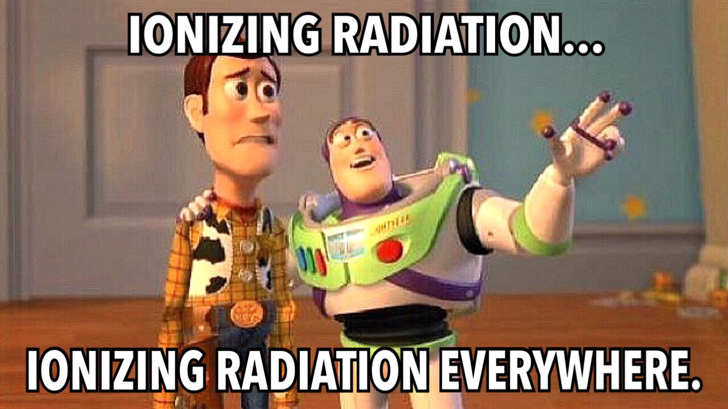
Good luck!

